Slide 1
Music Genre Classification
Toluwani, Finn, Safwan

Slide 2



Intro
Using the GTZAN Genre Collection.
10 genres (Blues, Classical, Country, Disco, Hip-hop, Jazz, Metal, Pop, Reggae, Rock), with 100 tracks per genre.
ML Models
Librosa
Traditional signal processing approach
Image based
Convert the audio clips into spectrograms and train neural network to classify the genre using sound patterns
Modern deep learning approach

Slide 3
Milestones
Milestone 1: Data Architecture & Preprocessing | Validate 1,000 GTZAN tracks; handle corrupted .au files (e.g., jazz.00054). Implement a stratified 70/15/15 split to ensure genre balance across training and testing.
Milestone 2: Multi-Dimensional Feature Engineering | Extract acoustic "fingerprints" using Librosa. Key metrics: MFCCs (timbre), Spectral Centroid (brightness), Chroma (harmony), and RMS Energy (amplitude). Export to structured CSV.
Milestone 3: Traditional ML & Baseline Performance | Benchmark classification using Random Forest and SVM. Apply StandardScaler for normalization. Evaluate via Confusion Matrices to identify "style-overlap" (e.g., Rock vs. Metal).
Milestone 4: Deep Learning & Neural Architectures | Convert audio to Mel-Spectrograms (image-based sound). Train a Convolutional Neural Network (CNN) to "see" musical patterns, leveraging computer vision for higher accuracy.
Milestone 5: AI vs. Human Discriminator | Pivot to binary classification. Train the model on a new dataset of Suno/Udio (AI) vs. GTZAN (Human) to identify "spectral artifacts" unique to generated audio.

Slide 4
Milestone 1: Data Integrity
Goal: Prove that your dataset is high-quality and free of technical glitches that ruin models.
Action Taken: Implemented an automated Integrity Audit using librosa to bypass the "GTZAN Dead File" issue.
The "Why": Standard datasets like GTZAN often contain corrupted headers (notably jazz.00054.au). Processing these without a filter causes "Silent Failures" or crashes during deep learning training.

Slide 5
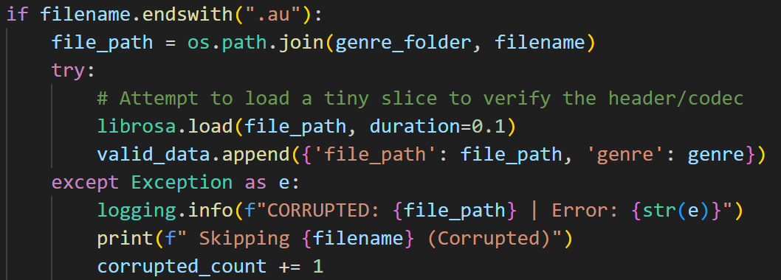
Data Integrity

Slide 6
Milestone 1: Data Architecture & Preprocessing
Goal: Show prevention of model bias through stratified sampling.
Engineered a Stratified 70/15/15 Split to ensure perfectly balanced representation across Training, Validation, and Testing sets.
If a model sees more "Rock" than "Jazz" during training, it will develop a bias. Stratification ensures that the 10% frequency of each genre is maintained across all three data subsets.
Process Architecture:
Split 1: 70% of each genre allocated to Training.
Split 2: The remaining 30% split 50/50 into Validation (15%) and Testing (15%).

Slide 7
Milestone 2: Feature Extraction
Action: Developed a Signal Processing pipeline using librosa to reduce dimensionality from 660,000 raw samples per track to 60+ core statistical features.
Feature Selection Strategy:
Timbre (MFCCs 1–20): Expanded extraction beyond the standard 13 coefficients. Crucial for Milestone 4: High-frequency MFCCs are where AI-generated artifacts typically hide.
Brightness (Spectral Centroid): Quantifies the "center of mass" of the frequency spectrum to separate high-energy genres (Metal) from low-energy (Classical).
Rhythm/Energy: Calculated RMS Energy and Amplitude Envelope to capture the track's dynamic range.

Slide 8
Milestone 2: Data Engineering & Validation
Focus: Evidence of success, data integrity, and preparation for ML.
Throughput & Success Rate:
Processed 1,000 tracks across 3 splits (Train: 700, Val: 150, Test: 150).
Result: 0% failure rate. Every .au file was successfully parsed into the _features.csv format.
Key Coding Adjustments:
Noise Filtering: Implemented warnings.filterwarnings('ignore') to handle specific librosa/audioread metadata warnings, ensuring a clean automated batch process.
Normalization Ready: Prepared data for Milestone 3 by organizing columns so that the Target Variable (Genre) remains attached to the feature vector.
Data Summary:
Input: Raw 30s .au files (approx. 1GB total).
Output: Three lightweight CSVs (approx. < 2MB total).
Conclusion: The data is now "ML-Ready"—mathematically dense, labeled, and scaled-ready.

Slide 9
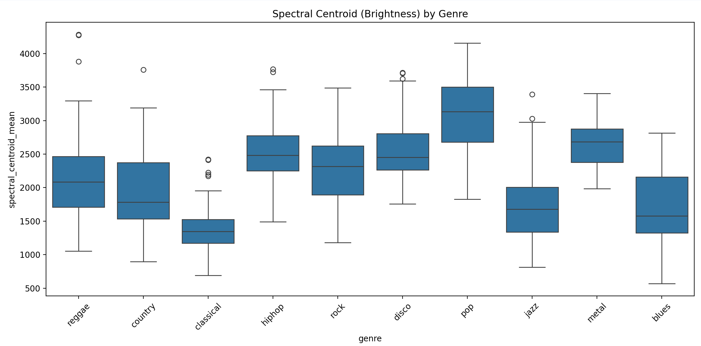

Slide 10
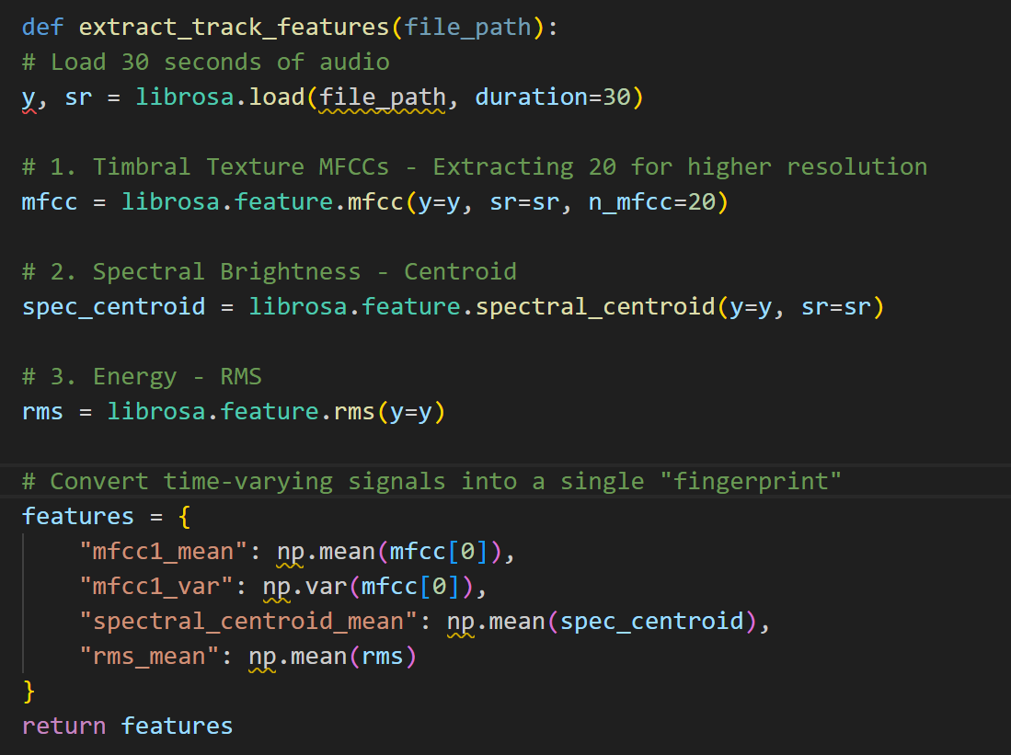

Slide 11
Milestone 3:Statistical Modeling & Hyperparameter Optimization

Slide 12
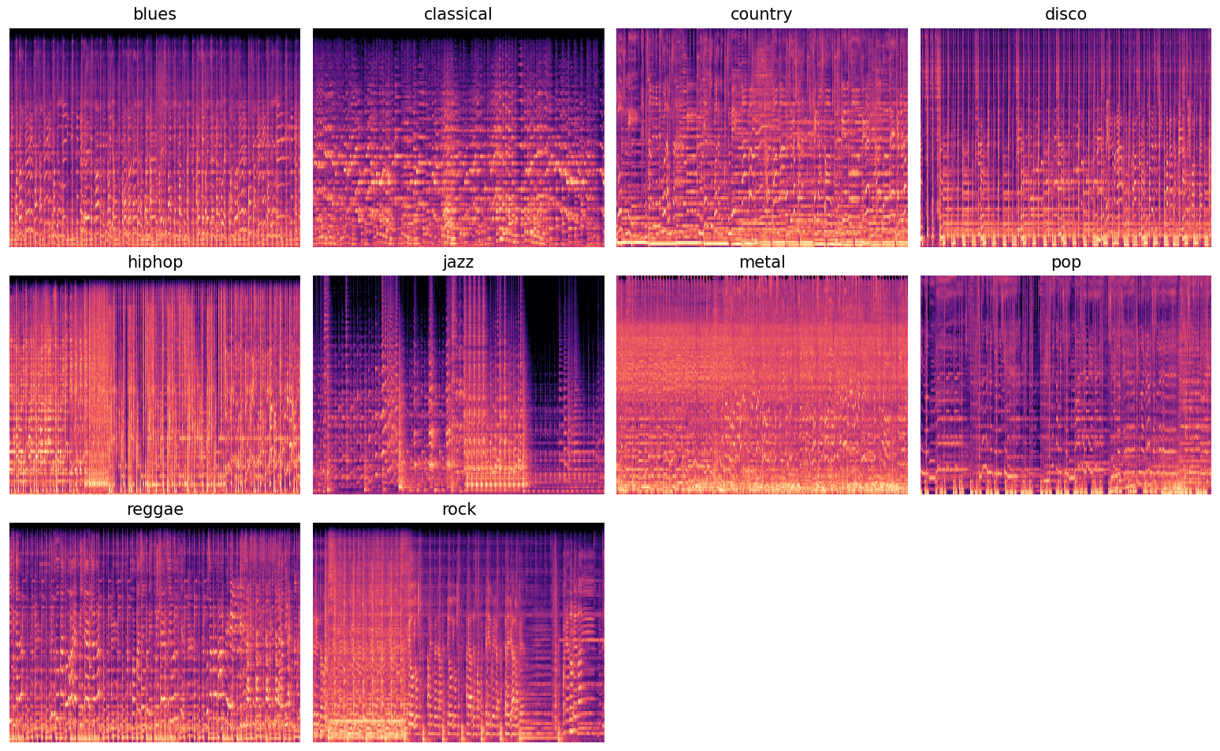
Spectrogram Generation

Slide 13
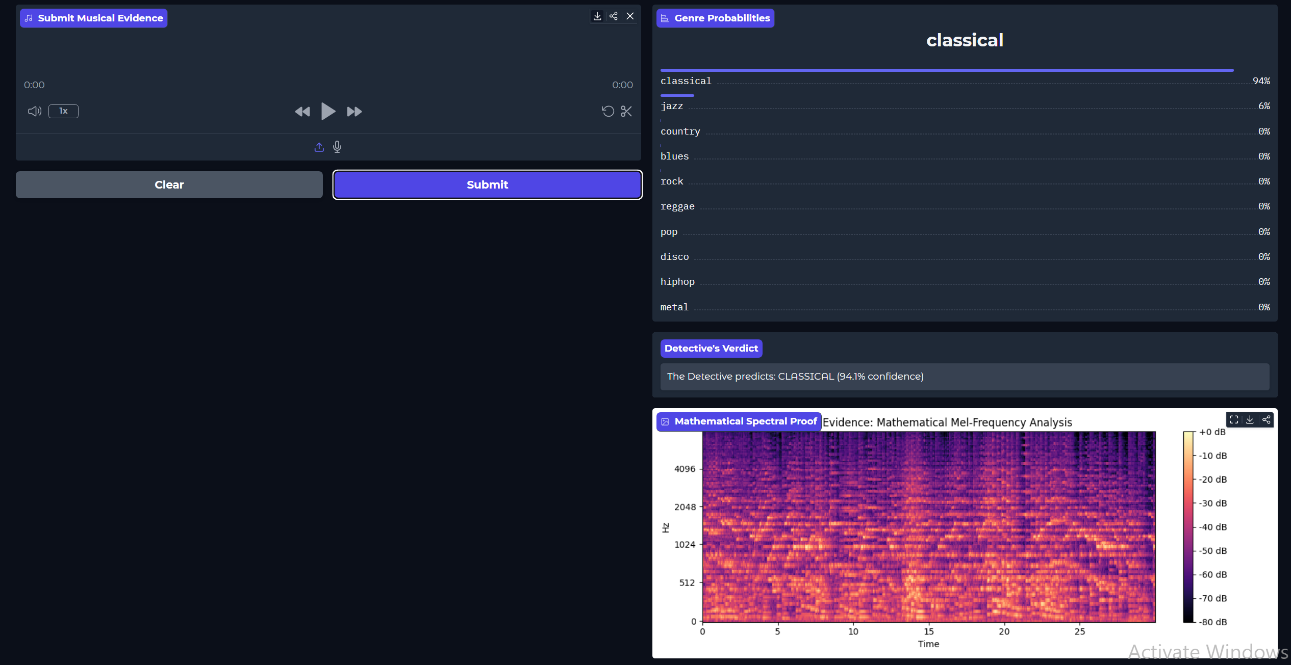
Spectrogram Generation

